Slide 1




Orientation Handbooks: Chimney Sweeping Your Welcome Guide
MCANJ Conference
Thursday, February 26, 2025
Sharon Dragan, Esq. of Mason, Pierson & Griffin, P.C.
Michele Bobrowski, RMC/MMC, Township of Alexandria

Slide 2
Table of Contents
What the Municipal Clerk needs to pull out of her Mary Poppins Bag to create an Orientation Handbook for their Elected Officials
Your Table of Contents Should Include the following:
1.) Demographics of the Municipality/History/Incorporation
2.) Roles and Responsibilities of the Elected Officials
3.) State Statute that references your form of government
4.) Duties/Job Responsibilities of the Office Staff
5.) Duties/Responsibilities of Police & Fire Department (if your Municipality has one)
6.) Open Public Meetings Act (OPMA) Requirements
7.) Executive Session Etiquette (What can/can’t be discussed in closed session)
8.) Open Public Records Act/Freedom of Information Act
9.) Ethics Law
10.) Finance/Budget Requirements/Deadlines
11.) Public Contract and Pay to Play Requirements
12.) Employee Handbook/Personnel Practices

Slide 3
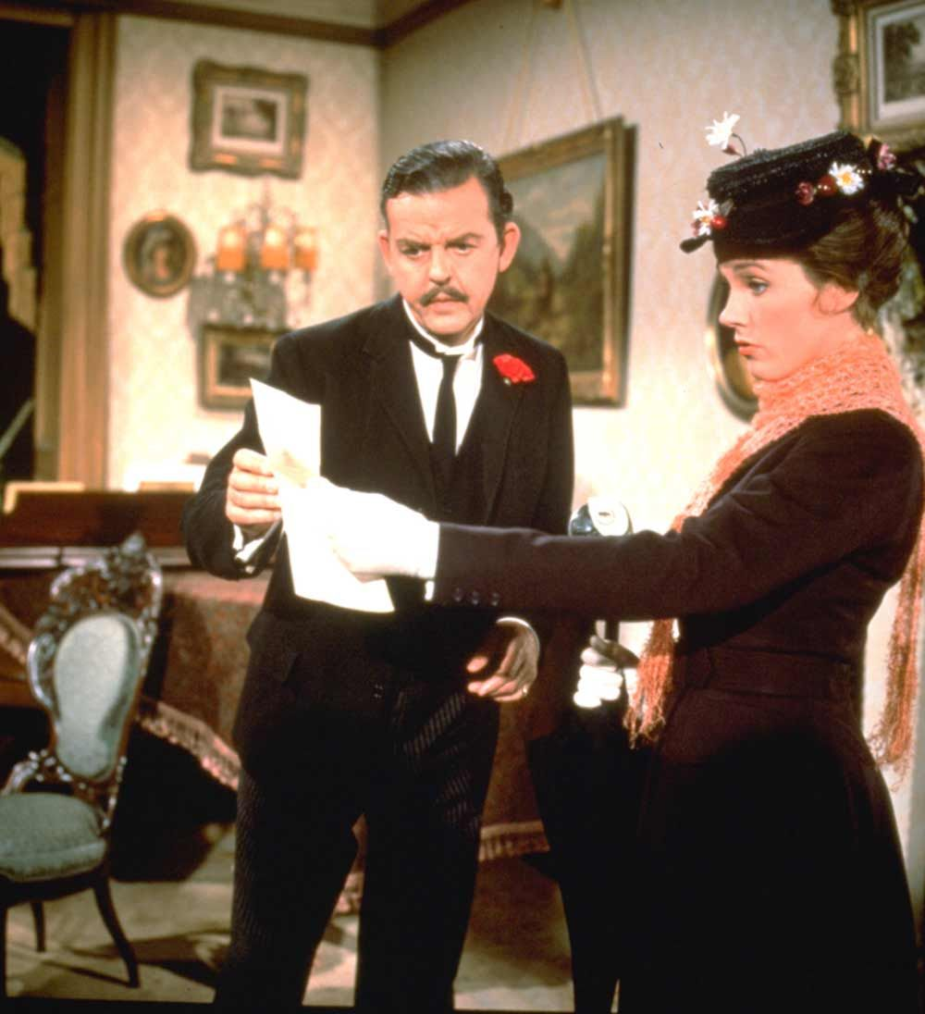
A Municipal Clerks Job Is Never Done

Slide 4

N.J.S.A. 40A:63-1. Incorporation
a. The inhabitants of each of the several townships are hereby continued as a body politic and corporate in law as heretofore constituted and established and shall be known by the name of “the township of ․․․․․․․․․․․․․․․․․․․․․․․, in the county of ․․․․․․․․․․․․․․․․․․․․․․․․” (as the case may be), and the boundaries of the several townships shall be and remain as heretofore established by law.
b. No suit, proceeding or instrument shall abate or anywise be affected by any changes in the corporate name of the township.
c. Each township, governed by the laws pertaining to the township form of government, shall have full power to sue and be sued and have corporate seal.
Alexandria Township is a Township in Hunterdon County, in the U.S. State of New Jersey. As of the 2020 United States census, the Township's population was 4,809, a decrease of 129 (−2.6%) from the 2010 census count of 4,938, which in turn reflected an increase of 240 (+5.1%) from the 4,698 counted in the 2000 census.
Alexandria was formed by Royal charter on March 5, 1765, from portions of Bethlehem Township, and was incorporated as one of New Jersey's initial 104 townships by an act of the New Jersey Legislature on February 21, 1798. Portions of the township were taken to form Frenchtown (April 4, 1867), Holland Township (April 13, 1874, restored to Alexandria on March 4, 1878, and recreated on March 11, 1879) and Milford (April 15, 1911). The township was named for James Alexander, a surveyor who served as New Jersey Attorney General and who had acquired 10,000 acres (4,000 ha) of land in the area in 1744.
Geography
According to the United States Census Bureau, the township had a total area of 27.75 square miles (71.87 km²), including 27.53 square miles (71.31 km²) of land and 0.22 square miles (0.56 km²) of water (0.79%).
Unincorporated communities, localities and place names located partially or completely within the township include Everittstown, Little York, Mechlings Corner, Mount Pleasant, Mount Salem, Palmyra and Swinesburg. Pittstown is an unincorporated community that is also spread across Franklin Township and Union Township.
The Township borders the municipalities of Bethlehem Township, Franklin Township, Frenchtown, Holland Township, Kingwood Township, Milford and Union Township in Hunterdon County; and both Bridgeton Township and Tinicum Township in Bucks County across the Delaware River border with the Commonwealth of Pennsylvania.

Slide 5

What is your Form of Government
Explain what form of Government you are:
Alexandria Township is governed under the Township form of New Jersey municipal government, one of 141 municipalities (of the 564) statewide that use this form, the second-most commonly used form of government in the state. The governing body is comprised of a five-member Township Committee, whose members are elected directly by the voters at-large in partisan elections to serve three-year terms of office on a staggered basis, with one seat coming up for election each year as part of the November general election in a three-year cycle. At an annual reorganization meeting, the Township Committee selects one of its members to serve as Mayor and another as Deputy Mayor.
There are State Statutes that describe the form of government-It is best to include that in your manual !
Types
All 564 municipalities in New Jersey, regardless of their form of government, can be classified as belonging to one of five types of municipal government:
Borough
Township
City
Town
Village
Forms
All 564 New Jersey municipalities, regardless of type, can be classified under one of the 12 forms of government:
Borough
Township
City
Town
Village
Commission
Council-Manager Act of 1923
Faulkner Act-OMCL Mayor-Council Plan
Faulkner Act-OMCL Council-Manager Plan
Faulkner Act-OMCL Small Municipality Plan
Faulkner Act-OMCL Mayor-Council-Administrator Plan
Special Charters
The first five forms are associated with a particular type of municipality. Each of these five types has a unique form of government historically associated with it. The next seven forms are "optional" forms of government available for adoption, with the exception of the OMCL Small Municipality Plan (which is available only to municipalities with a population of under 12,000).

Slide 6

What is your Municipalities Duties?
N.J.S.A.40A:63-6-Township Committee
a. The Committee shall be the legislative body of the municipality.
b. The Committee may subject to general law and the provisions of this act:
(1) pass, adopt, amend and repeal any ordinance or, where permitted, any resolution for any purpose required for the government of the municipality or for the accomplishment of any public purpose for which the municipality is authorized to act under general law;
(2) control and regulate the finances of the municipality and raise money by borrowing and taxation;
(3) create such offices and positions as they deem necessary. The officers appointed thereto shall perform the duties required by law and the ordinances of the committee. Other than the Township Attorney, Engineer, Building Inspector, the Municipal Clerk, Tax Collector and Tax Assessor who shall serve for terms as provided in Chapter 9 of Title 40A of the New Jersey Statutes, these officers shall serve at the pleasure of the committee;
(4) investigate any activity of the municipality; and
(5) remove any officer of the municipality, other than those officers excepted by law, for cause.
c. The committee shall have all the executive responsibilities of the municipality not placed, by general law or this act, in the Office of the Mayor.
Mayor’s Duties? Well, there is a Statute for that too-N.J.S.A. 40A:63-3.f:
“At their annual meeting, the Committee shall have the power and authority to elect one of their number as chairman of the committee, who shall preside at all meetings of the Township Committee and who shall be known as the Mayor of the Township. The Mayor shall have no additional authority by virtue of such designation, except as otherwise provided by law or this act .”

Slide 7
What Are Some of Other Forms of Government for our IIMC Region II Family?
In New Jersey, we know there are 564 municipalities and 21 Counties. We went over our forms of government. Let’s take a look at Delaware, Maryland, Virginia, West Virgina and Pennsylvania who make up Region II:
Pennsylvania: Has six (6) types of local government listed in the Pennsylvania Constitution:
1.) County
2.) Township
3.) Borough
4.) Town
5.) City
6.) School District
There are 67 Counties in the Keystone State with a whopping 2,560 municipalities and 500 school districts.
There are no independent cities in Pennsylvania or unincorporated territories. There is only one incorporated town-Bloomsburg!
Local municipalities can be governed by statutes, which are enacted by the Pennsylvania General Assembly, and are specific to the type and class of municipality; by a home rule municipality, under a home rule charter, adopted by the municipality; or by an optional form of government, adopted by the municipality.^{[3]} The township is the basic population center or town element in Pennsylvania, ranging in size from small hamlets to important population centers. These are given Class I or Class II powers, attributes, and responsibilities, and comprise the majority of communities in Pennsylvania.
Delaware: Has 57 incorporated municipalities and only 3 County’s. Incorporated Municipalities in Delaware are chartered by the Delaware General Assembly.
These 57 incorporated municipalities in Delaware function under charters granted by the General Assembly enabling them to elect their own governing bodies and to exercise the powers granted under their charters. Many sizable communities or neighborhoods, particularly in populous New Castle County, that range in population from 100 to 15,000 are not incorporated and therefore are not self-governing. They are described as "in the county," which represents their most immediate branch of government.
Elections for municipal officials are non-partisan, except for Wilmington. Some elections are held annually, others in alternate years.
The governing bodies are similar. Titles and descriptions are listed below:
Mayor and Council - all elected.
Mayor and Commissioner - all elected.
President and Council – Council elected with the President being elected from among their number at the organization meeting following election.
President and Commissioners, same as in President and Council.
Trustees and Town Meeting - Arden, Ardencroft and Ardentown in New Castle County are unique. They have self-perpetuating Boards of Trustees. Upon death of a trustee the remaining trustees elect a successor. Only in Arden can the 'lease-holders' confirm or reject election of the trustee. At the annual town meetings, the leaseholders elect the secretary, treasurer, and the various committees.
The governing bodies of 12 municipalities appoint a city or town manager as administrator

Slide 8

Municipal Clerk Fun Fact-Who is this Delaware Elected Official?

Slide 9

Deputy Mayor of Millville, Delaware
Sharon Brienza, former Municipal Clerk of Branchburg, NJ (Somerset County) where she held that title for 29 years was first elected to join the council of Millville in 2019. Sharon is serving her 3rd term on council.

Slide 10
What is your form of Government
In the State of West Virginia, there are 230 incorporated municipalities and 55 Counties.
Under Chapter 8 of the West Virginia Code forms of government are defined as:
IV. The City Charter.
In the case of a Class I, II, or Ill city, the charter is the essential document providing the form of government and the exercise of powers and duties permitted to municipalities.
A. The Charter Board- §8-3-1
In an election on the question of the incorporation of a city the voters also vote for a charter board consisting of 11 members for a Class I or II city and 7 members for a Class III city.
Each member must have been a resident of the territory to be incorporated for at least two years and qualified to vote for at least two years.
Member are nominated by petition to the county commission of not less than 200 qualified voters.
The election of the members of the charter board is non-partisan. A very unusual provision concerning the election of the charter board is that the voters have cumulative voting and may cast their 7 or 11 votes for one candidate or divide them among the candidates as they wish.
B. Form of Government §8-3-2
One of the most important duties of the charter board is determination of the form of city government. These are as follows:
1. Mayor-Council Plan.
This involves an elected city council and elected mayor, with the mayor and council being both the governing body and administrative authority.
2. Strong Mayor Plan.
The mayor and council are elected and the council is the governing body, with the mayor the administrative authority.
3. Commission Government.
A Commission of five members are elected by the voters, who elect a mayor from among their membership. The commission is both the governing body and administrative authority.
4. Manager Plan.
A council of 5 to 11 members are elected, and council elects the mayor from among its membership as its presiding officer and appoints the city manager. The council is the governing body, and the
manager is the administrative authority.
5. Manager-Mayor Plan.
Council and the mayor are elected by the voters. Council is the governing body, and the manager, appointed by council is the administrative authority.
Under all except the Commission government, the council members may be elected at large, by wards, or in combination.

Slide 11
What is your form of Government
Maryland’s Form of Government: Of the 50 states, Maryland is among those with the fewest number of local governments.
County Government.
Local government is found in Maryland's 23 counties. There, three forms of government exist: county commissioners, code home rule, or charter.
County Commissioners. Under the county commissioners form of government, the General Assembly is authorized to legislate for a county. While a board of county commissioners exercises both executive and legislative functions defined by State law, and may enact ordinances, its legislative power is limited to those areas authorized by the General Assembly, enabling legislation, or public local laws.
All Maryland counties formerly had boards of county commissioners, however, only twelve counties continue to operate in this fashion today.
Code Home Rule. Since 1915, counties have had the option of governing under code home rule, which enables them to exercise broad local legislative authority (Chapter 493, Acts of 1965, ratified Nov. 8, 1966; Const., Art. XI-F). Six counties have chosen to adopt code home rule government.
Charter. The charter government separates the executive branch from the legislative Charter government covers eleven Maryland counties.
Municipal Government. Some 157 municipalities consist of towns, villages and cities (including Baltimore City) have their own governments. Created by State, county and municipal governments.
Maryland does not have minor civil divisions such as “Townships” outside of municipalities and have no government below the County level. Municipalities are self governed except for Baltimore City by an Act of the Maryland General Assembly or in some cases, by referendum. Despite being a city, town or village there are no differences in municipal power and authority.
Virgina is for Lovers Form of Government:
What is the difference between cities and towns in Virginia? Towns are inside counties; cities are separate from counties. There are 38 cities and 189 towns in Virginia.
City Government:
Mayor –Council Form-The council is elected by people in districts within the city/ town. Mayor may be elected by the people or appointed by the Council .
Council-Manager Form-Council is elected by the people in districts. Mayor is appointed, in weak position. City Manager is hired by Council to head the city departments - prepares the city budget - has no power check on council . Council serves as legislature. The advantage was to have a professional run the city, rather than a politician.
Virgina has 95 Counties
The Commonwealth has 38 cities, as of July 1, 2022. Virginia cities, however, are distinct from cities in other states in that they are independent governmental entities. No county authority or taxing power extends within the boundaries of a Virginia city. Due to this situation, cities in Virginia are also required to serve like counties as administrative subdivisions of the state for the implementation of state programs and policies.
As is the case with towns in Virginia, 37 of the 38 cities in the Commonwealth operate under Council-Manager Form of government. The City of Richmond, however, is the only city to operate under the Strong Mayor Form.

Slide 12
Employee Position/Roles
Place a Chapter listing all the employees who work for the municipality. For an example for NJ some of these positions are:
Municipal Clerk (mandated by statute)
Township Attorney
Township Engineer
Tax Collector (mandated by statute)
Tax Assessor (mandated by statute)
Chief Financial Officer (mandated by statute)

Slide 13
Examples of Position/Roles
Administrator
1.) Authorized by statute (N.J.S.A 40A:63-7) and by Twp. Ord. 2016-010;
2.) Appointed by the Township Committee
3.) Governing body can delegate all or a portion of the municipality’s executive responsibilities to an Administrator.
Tax Collector
1.) Required by Statute (N.J.S.A. 40A:9-141 et. seq)
2.) Appointed by the Township Committee
3.) Serves a term of 4 years
4.) Becomes tenured upon reappointment after the completion of one full four year term or having performed the duties of Tax Collector for not less than four consecutive years, after which can only be removed for good cause shown after a fair and impartial hearing, and based on a written complaint setting forth specific charges (N.J.S.A. 40A:9-145.8
5.) Responsible for collecting taxes on real and personal property in the municipality.

Slide 14
Municipal Clerk Qualifications
(Registered Municipal Clerk)
Must Successfully Complete 5 Rutgers University Administered Courses:
  Introduction to the Duties of Mun. Clerk
  Local Elections Administration
  Information and Records Management
  Advanced Duties of Municipal Clerk
  Municipal Finance Administration
Passage of State Exam (Min. Grade 80 Req.)
Re-Certification Required Every 2 Years

Slide 15
Municipal Clerk Position in NJ
Secretary to the Municipal Corporation
  Maintain custody of all minutes, books, deeds, bonds, contracts and archival records
  Keepers of the Municipal Seal
  Meeting Notices in Compliance with OPMA (Open Public Meetings Act)
  Official Served with Tort Claim Notices, Summons, Lawsuits and Other Related Documents
  Attest to the signature of municipal officials

Slide 16
Municipal Clerk Position in NJ-continued
Secretary to the Governing Body
  Preparation of Agendas, Minutes, Resolutions, Ordinances and Administers Oaths to Officials
  Attends all Governing Body Meetings - Both Open and Executive
  Oversees the Codification and Necessary Update of Ordinances
  Parliamentary Procedures Robert’s Rules of Order

Slide 17
Municipal Clerk Position in NJ
Chief Administrative Officer of all Elections
Chief Registrar of Voters in the municipality
Administrative Officer
Records Coordinator and Manager
Other duties that may be imposed by statute

Slide 18
Sample websites of Municipal Clerks in Region II
City of Dover Delaware - City Clerk
City Council | Charlottesville, VA
Office of the City Clerk | Laurel, MD
Alexandria NJ - Township Clerk

Slide 19

Committee Actions
Provide a section explaining what a quorum is by state statute as a majority of the Governing Body including the Mayor.
Explain the different types of actions they will need to act on:
Ordinances
Resolutions
Motions

Slide 20
Committee Actions
Ordinances - Are Legislative in Nature and Requires Tw0 (2) Readings (Requires Notice & Public Hearing-provide a sample of each in this section)
Any repealer must also be effectuated by Ordinance
Place the required voting needed to pass an Ordinance
Explain that an Ordinance must be fully adopted in the same year introduced unless there is no change in the membership of the Governing Body in the following year

Slide 21
Committee Actions
Resolutions-May Be Passed When Introduced
  Procedural Requirements to Amend or Repeal a Resolution is Accomplished by the Same Means
Resolution May Not Amend or Repeal an Ordinance
Resolutions and motions are not permanent
Place the required voting needed to pass a resolution (are passed in a single night and require only a simple majority of those Governing Body members who are present and eligible to vote.

Slide 22
SOURCES OF BASIC LAW
Chapter Laws - Compilation of laws passed during a legislative session and signed by the governor (Example Chapter 174 of the Laws of 2012 would be cited as P.L. 2012, c174)
New Jersey Statutes Annotated - Unofficial compilation of legislation currently in effect.
New Jersey Administrative Code - The “how to” book of rules, regulations and other documents issued by state agencies.

Slide 23
Your Critical Municipal
Documents
Codified Ordinances (General and Land Use)
Note: If online-provide the website link
Administrative Code (if you have one)
Budget Document (Provide website link)
Master Plan (Provide website link)
Official Statement
Rules of Order by By-Laws Regarding Conduct at Meetings

Slide 24
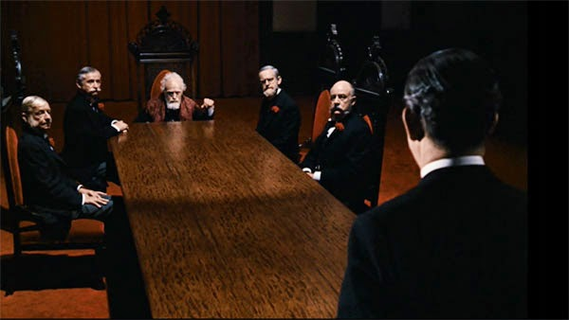
Rules of Order
Parliamentary Procedures
  Motions - How a Meeting is Transacted
    Privileged Motion - Not Related to Pending Business but to Special Matters of Immediate & Overriding Importance Which, Without Debate, Should Be Allowed to Interrupt the Consideration of Anything Else
      Fix Time to Which to Adjourn (Set Time for Next Mtg.)
      Adjourn
      Recess
      Question of Privilege
      Orders of the Day

Slide 25
Rules of Order Cont’d
Parliamentary Procedures Cont’d
  Motions
    Main Motion- To Commit the Governing Body to Action.
    Subsidiary Motion - Change the Wording, Controls the Discussion or Disposes of a Main Motion Without Accepting or Rejecting It
      Lay on the Table
      End Debate
      Limit or Extend Debate
      Postpone to a Definite Time or Postpone Indefinitely
      Refer to Committee
      Amend

Slide 26
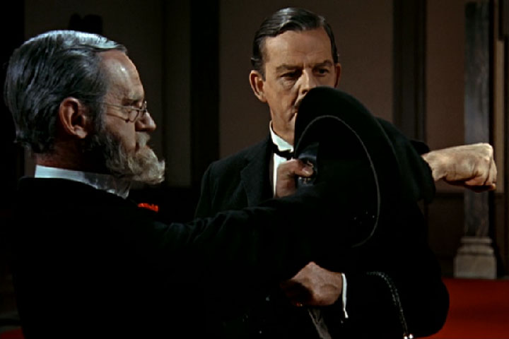
Rules of Order Cont’d
Parliamentary Procedures Cont’d.
  Incidental Motions - Questions of Procedure
    Division of Question
    Division of Assembly
    Withdraw or Modify a Motion
    Object to Consideration
    Point of Order
    Parliamentary Inquiry
    Point of Information
    Appeal From Decision of the Chair
    Suspend a Rule

Slide 27
Day to Day Statutes that Govern Municipal Functions
N.J.S.A. 40:48-1 et seq. General and Regulatory Powers
N.J.S.A. 40A:4-1 Local Bond Law
N.J.S.A. 40A:4-1 Local Budget Law
N.J.S.A. 40A:5-1 Local Fiscal Affairs
N.J.S.A. 40A:9-1 Officers & Employees
N.J.S.A. 40A:9-22.1 et seq Local Government Ethics Law
N.J.S.A. 40A:11-1 et seq Local Public Contracts Law
N.J.S.A 40A:14-7 et seq Fire & Police
N.J.S.A. 40:55D-1 et seq Municipal Land Use Law
N.J.S.A. 10:4-1 et seq Open Public Meetings Act
N.J.S.A. 47:1-1 et seq Open Public Records Act
N.J.S.A. 40:56-1 Local & other improvements/assessments therefor
N.J.S.A. 40A:12-1 et seq Local Lands and Buildings Law
Title 39

Slide 28
Open Public Meetings Act
The “Sunshine Law,” otherwise known as the Open Public Meetings Act (OPMA), gives the public the right to be present at meetings of public bodies and to witness in full detail the deliberation, policy formulation and decision making of public bodies. Law became effective on January 19, 1976 (P.L. 1976, c. 231)
What does the Sunshine Law require?
The Sunshine Law requires public bodies to provide the public with:
Adequate advance notice of all its meetings;
The right to attend its meetings; and
Reasonably comprehensive minutes of all meetings.
Who is covered under the Sunshine Law?
The law applies to any “public body” of the state, county, or municipal level of government. N.J.S.A. 10:4-7
A “public body” is defined as any commission, authority, board, council, committee or group of two or more organized under the laws of this state that:
Is collectively empowered as a voting body and performs a public governmental function affecting the rights, duties, obligations, privileges, benefits, or other legal relations of any person; or
Is collectively authorized to spend public funds.
The law does not apply to the judiciary, juries, parole boards, the State Commission of Investigation, the Apportionment Commission, political party committees or any purely advisory committees.
What meetings are subject to the Sunshine Law?
A public body’s meeting is subject to the law if it is:
Open to all the public body’s members;
Attended by an effective majority of the members of that public body, regardless of whether they attend in person or by telephone or other means of communication; and
Held with the intent to discuss or act upon public business.

Slide 29
Open Public Meetings Act
Are all meetings open to the public?
The Sunshine Law generally requires all meetings of public bodies to be open. However, a public body may exclude the public from portions of a meeting, commonly referred to as “executive” or “closed” sessions. N.J.S.A. 10:4-12
Before going into a closed session, a public body must first adopt a resolution at a meeting which is open to the public stating:
The general nature of what will be discussed in the closed session; and
The time when the information discussed in private will be disclosed to the public.
When can public bodies exclude the public from a meeting?
The Sunshine Law allows public bodies to exclude the public when discussing:
Matters considered confidential by law or court rule;
Matters that would diminish the chances of receiving federal funds if released to the public;
Material which would constitute an unwarranted invasion of individual privacy;
Collective bargaining agreements, including negotiations about them;
Matters involving investments of or real estate transactions with public funds, or the setting of banking rates, where disclosure of information could adversely affect the public interest;
Tactics and techniques used in protecting the safety and property of the public and investigations of violations or possible violations of the law; Pending or anticipated litigation or contract negotiations involving the public body, and matters covered by the attorney-client privilege;
Personnel matters including the employment, appointment or termination of current or prospective employees (unless affected individuals request for the matter be discussed); or
Deliberations that could result in a fine or the suspension or loss of a license or permit (but only after an initial public hearing on that subject).

Slide 30
Open Public Meetings Act
How much advance notice is required?
Public bodies are required to provide the public with “adequate notice” of all their meetings. Adequate notice may be provided:
On an annual basis; or
At least 48 hours prior to each meeting.
Public bodies providing annual notice must provide the time, date, and location (if known) of each meeting, within seven days of the annual organization or reorganization meeting of the public body. If there is no organization or reorganization meeting, such a notice must be provided by January 10th.
If a public body wishes to reschedule a meeting or convene a meeting not listed on the annual notice, it must provide 48 hours notice. The notice must contain the time, date, location and, to the extent known, the agenda of the meeting.
All notices must be:
Posted in at least one public place reserved for public announcements;
Published in two newspapers; Note: New Publishing Law that takes effect March 1st
Filed with appropriate Municipal or County Clerk or the Secretary of State if the public body has statewide authority;
Mailed to any person upon request.

Slide 31
Open Public Meetings Act
What if an urgent matter arises?
A public body should provide adequate notice for all meetings, but may convene without notice if all of the following criteria are met:
Three-quarters of the members present vote in favor of conducting a meeting without notice;
The meeting is required to deal with urgent or important matters and a delay for the purpose of providing adequate notice would likely result in substantial harm to the public interest;
The meeting is limited to only the urgent and important matters;
Notice of the meeting is provided as soon as possible; and
The need for such a meeting could not have been reasonably foreseen at a time when adequate notice could have been provided, or such need could have been foreseen and the public body subsequently provides reason(s) why adequate notice was not provided.
Public bodies are required to provide a statement in the meeting minutes detailing the urgent matters, the time, place and manner, that notice was provided and other information related to the criteria listed above.

Slide 32
Open Public Meetings Act
What kind of meeting minutes are required?
Public bodies must keep “reasonably comprehensible” minutes of all their meetings. At a minimum, the minutes must reflect the time and place, members present, subjects considered, actions taken, and the votes of each member. They are not required to be verbatim!

Slide 33
Open Public Meetings Act
Agendas - Preparation/Distribution
  Must Be Made Available to the Public
  Should Be Concise and Well Organized
  Standard Order of Business May Be Suspended
Consent Agenda - Provides Rapid, Effective Action on Routine, Non-Controversial Matters Needing No Discussion
* Provide samples of each

Slide 34
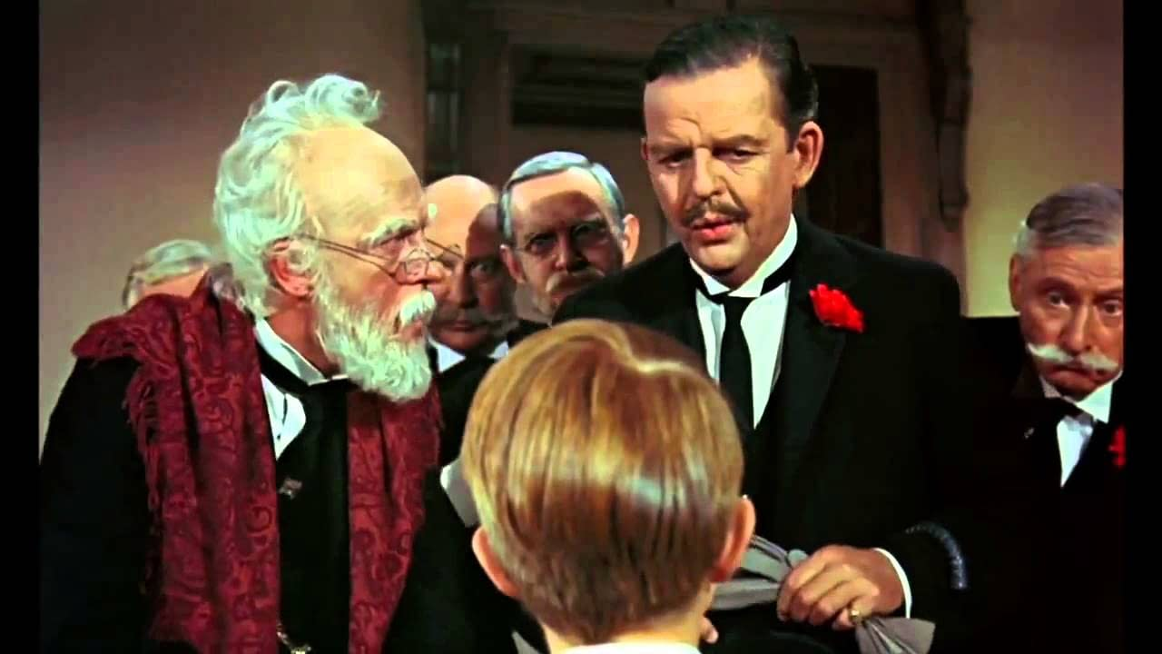
Some Frequently Asked Questions Section
Are all political caucus meetings exempt from the law?
What is a chance social encounter?
What kind of meeting with Advisory Boards is exempt from the Act?
How far does the definition of “public body” go?
Must all participants be physically present in a room to hold a meeting?
Are subcommittees lawful?
How specific should a resolution going into executive session be?
What about minutes of Executive Session?
*You can get these questions/answers from the NJLM Open Public Meetings Act booklet

Slide 35
Public Meeting Tips
Review Your Meeting Materials in Advance of Meeting (Not Being Prepared Becomes Obvious to Those in Attendance)
Reach Out to Your Municipal Clerk or Business Administration with Questions About the Agenda
Asking Questions at the Meeting is Perfectly Acceptable - Provides for Transparency

Slide 36
Open Public Records Act (OPRA)
P.L. 2001, Chapter 404 - Statutory Right to Access Records that are Made, Maintained and Kept on File or Received in the Course of Official Business
Municipal Clerk is the Official Designated to Address Requests (Records Custodian)
Many Towns Must Hire Outside Legal Counsel
Law was amended & took effect September 3, 2024

Slide 37

Open Public Records Act (OPRA)
Include a copy of the law
Provide a list of exemptions
Include the definition of OPRA/Common Law
Reiterate that their emails/texts are subject to OPRA & the records retention period.
Provide a copy of your OPRA form or link to website
Does your town have a policy for Governing Body members accessing records within the Township? If so, include it!

Slide 38
Open Public Records Act Tips
Do Not Use Your Personal Email Address or Cell Phone to Conduct Official Business
Official Business Emails Must Be Kept for Seven (7) Years
Violations/Penalties (Municipal and Civil)
  1st Violation - $1,000
  2nd Violation - $2,500
  3rd Violation - $5,000

Slide 39
Region II Open Public Records Acts
Virginia Freedom of Information Act
What is the Virginia Freedom of Information Act?
The Freedom of Information Act (FOIA) makes the records of federal agencies accessible to citizens, upon request, except for certain exemptions. Virginia's version of the federal Act is the Virginia Public Records Act (VPRA) which is codified under Section 42.1-76 et seq. of the Code of Virginia. The VPRA guarantees citizens of Virginia access to public records held by public officials, public bodies, and public employees of the Commonwealth of Virginia. The VPRA establishes a single body of law applicable to all public officers or employees, ensuring that procedures used in managing and preserving public records remain uniform throughout the commonwealth.
What is Covered Under the Virginia Freedom of Information Act?
All public records in the custody of public agencies in Virginia are covered under the Virginia Public Records Act. A public record is any recording or writing, regardless of the form of physical characteristics, such as a paper record, electronic file, audio recording, video recording, or any other format, that is owned or prepared by, or in possession of a public body. The record may also be prepared or owned by a public body's officer, employee, or agent in the transaction of public business. All public records are deemed open and may be restricted only upon the application of a particular legislative exception.
What Records are Exempt from the Freedom of Information Act in Virginia?
Certain specific categories of records are exempted from public disclosure under the Virginia Public Records Act. These exemptions are outlined in Sections 2.2.3705.1 through 3705.7 of the Code of Virginia. Common exemptions under the VPRA include:
1. Personnel records under Virginia Code § 2.2-3705.1(1)
2. Portions of public records containing account numbers or routing information for any debit card, credit card, or any other account with a financial institution of any individual or public body, except when requested by the subject of the record
3. Information protected by the attorney-client privilege
4. Legal memos and other work products compiled particularly for use in litigation or an active administrative proceeding
5. Information recorded or compiled exclusively for closed-meeting use
6. Portions of construction and engineering drawing and plans submitted for the sole purpose of complying with the building code or obtaining a building permit
7. Working papers of the mayor or chief executive office of a locality
8. Petit jury and grand jury records
9. Virginia Parole Board records
10. Family assessment and planning records
11. Text and examination records
12. State crime commission records
13. Appraisals of potential land sales and purchases
14. Individual, infrastructure, or telecommunications-related security records, including victim information
15. Intra-agency investigations, health investigations, lottery investigations, ongoing criminal investigations, investigations by the Board of Education, and labor relations information
16. Academic research and student and application records at public schools
17. Health records and information on health licensing
18. Financial statements and any other financial information provided voluntarily to a governmental agency
19. Executive and legislative branch working papers that are still under consideration
20. Library records
21. Account information for utility customers
22. Locations of sensitive environmental materials
23. Lottery record

Slide 40
Region II Open Public Records Acts
How Do I File a Virginia Freedom of Information Act Request?
To file a public record request in Virginia, follow these steps:
Determine the custodian of the record you seek: Virginia does not have a centralized public record repository. Therefore, a request for a public record must be made to the specific agency maintaining the record.
Find the public agency's record custodian: Although you can direct your request to the agency that is the record custodian, it is recommended that you verify if the agency has designated an officer or an arm of the agency as its custodian of public records. If an officer has been designated, you should direct the request to the custodian for a prompt response. Typically, the best place to obtain contact information for the public records officer is on the agency's website. If you cannot find the custodian's contact information, you may submit requests to the agency's contact address found on the agency's website.
Prepare and submit the public record request: Many public agencies maintain their own public records request forms on their website. You may fill the forms online, where possible, or complete a downloadable request form which must be mailed to the agency's mailing address. Most agencies prefer requesters to file their requests in writing. If a requester foresees that a need may arise to enforce the provisions of the VPRA, then it is recommended that the request be completed in writing. Written requests for public records should include as much information as possible to aid the custodian in finding the requested record. Typically, a written public record request should consist of:
Your name, address, and phone number
An accurate description of the requested record.
A statement requiring the custodian to provide non-exempt sections if the record contains information exempted from disclosure
The date period for the requested record
Any clues that may help the agency to locate the requested record.

Slide 41
Region II Open Public Records Acts
In 1977, the General Assembly adopted Delaware’s Freedom of Information Act (FOIA) to ensure that government is open and accountable to its citizens.
It is vital in a democratic society that public business be performed in an open and public manner so that our citizens shall have the opportunity to observe the performance of public officials and to monitor the decisions that are made by such officials in formulating and executing public policy; and further, it is vital that citizens have easy access to public records in order that the society remain free and democratic. Toward these ends, and to further the accountability of government to the citizens of this State, this chapter is adopted, and shall be construed.
29 Del. C. § 10001.
Q. How long does a public body have to respond to a FOIA request?
FOIA requires that a public body respond to a request for records as soon as possible, but no more than 15 business days after the request is received. A public body may respond by providing or denying access to the records, or if the request is for voluminous records, requires legal advice, or is for records in storage or archived, the public body may respond by citing one of these reasons for delay and providing a good faith estimate of the time frame in which a response will be provided.
Maryland Public Information Act Fee Schedule
The Maryland Public Information Act allows an agency to charge a reasonable fee for copies of public records.
An agency may also charge a reasonable fee for searching for a public record – a charge that may include the time required for locating and reviewing the record. The first two hours of search time are free, but an extensive search may prove time-consuming and therefore expensive.
Research and Preparation Fees
Hours 1 and 2: Free
2+ Hours: The actual cost of a response must be calculated by prorating the salaries of staff and attorneys involved in the response by the actual time they spent searching for and preparing the record for disclosure.
Materials
Photocopies: $0.25 cents per printed page
Compact disc: $10.00
New FOIA bill guts WV’s presumption of transparency

Slide 42
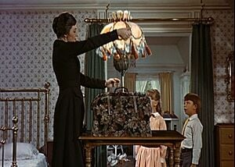
Region II Open Public Records Acts
Pennsylvania Right to Know Law
Providing for access to public information, for a designated open-records officer in each Commonwealth agency, local agency, judicial agency and legislative agency, for procedure, for appeal of agency determination, for judicial review and for the Office of Open Records; imposing penalties; providing for reporting by State-related institutions; requiring the posting of certain State contract information on the Internet; and making related repeals.
Section 506. Requests.
(a) Disruptive requests. —
(1) An agency may deny a requester access to a record if the requester has made repeated requests for that same record and the repeated requests have placed an unreasonable burden on the agency.
(2) A denial under this subsection shall not restrict the ability to request a different record.
Agency discretion. — An agency may exercise its discretion to make any otherwise exempt record accessible for inspection and copying under this chapter, if all of the following apply:
(1) Disclosure of the record is not prohibited under any of the following:
  (i) Federal or State law or regulation.
  (ii) Judicial order or decree.
(2) The record is not protected by a privilege.
(3) The agency head determines that the public interest favoring access outweighs any individual, agency or public interest that may favor restriction of access.
(d) Agency possession. —
(1) A public record that is not in the possession of an agency but is in the possession of a party with whom the agency has contracted to perform a governmental function on behalf of the agency, and which directly relates to the governmental function and is not exempt under this act, shall be considered a public record of the agency for purposes of this act.
(2) Nothing in this act shall be construed to require access to any other record of the party in possession of the public record.
(3) A request for a public record in possession of a party other than the agency shall be submitted to the open records officer of the agency. Upon a determination that the record is subject to access under this act, the open records officer shall assess the duplication fee established under section 1307(b) and upon collection shall remit the fee to the party in possession of the record if the party duplicated the record.

Slide 43
Local Government Ethics Law
N.J.S.A. 40A:9-22.1 et seq
New Jersey's ethics laws encompass various regulations aimed at ensuring integrity and accountability among public officials and employees, including the Local Government Ethics Law and the Legislative Code of Ethics.
The Local Government Ethics Law was enacted to establish clear ethical standards for local government officers and employees in New Jersey. Key points include:
Public Trust: The law emphasizes that public office is a public trust, and the integrity of elected and appointed representatives is crucial for maintaining public confidence in government.
Conflict of Interest: It aims to prevent conflicts between private interests and public duties, providing guidelines for ethical conduct and financial disclosure requirements for local officials.
Definitions: The law defines terms such as "local government officer," "local government employee," and "interest," which are essential for understanding the scope of the law.
Print out and include the State Statutes for each category.
Do you have a Municipal Ethics Board? Include that information in this section

Slide 44
Financial Disclosures
N.J.S.A. 9-22.6 Local Government Officers shall annually file a financial disclosure statement. You can look up this statue to include what they are required to file on the statement which is:
Name/Address
Source of Incomes
Gifts, reimbursements, etc.
Real estate owned

Slide 45

Local Fiscal Affairs
Audit Requirements
Budget Introduction/Adoption Deadlines
Township’s Cash Management Plan
How Municipal Bills are paid
How the municipality makes a purchase
Bid Threshold Limits
RFPs/RFQ Requirements for goods/services
Fair/Open Process
Awarding Contracts
* Provide Sample documents

Slide 46
Spit Spot on Social Media
Include your Social Media Policy and the expectations of the Governing Body when using their personal social media for anyone in Region II .
Include the following lawsuits:
22-611 Lindke v. Freed (03/15/2024)
Garnier v. O'Connor-Ratcliff, 41 F. 4th 1158 - Court of Appeals, 9th Circuit 2022 - Google Scholar
These were U.S. Supreme Court Cases that went on to U.S. Court of Appeals pertaining to when a government official's decision to block citizens from their social media accounts implicates the First Amendment. The cases focuse on when an official should be treated as a government actor as opposed to a private actor. Lindke provides some guidance for public officials wondering when the Constitution restricts their ability to manage their online accounts, but it leaves open other questions relating to when a public official's account should be treated as a public forum. The decision also has broader implications for lawsuits alleging other types of constitutional violations.
Both cases involved local officials who had blocked constituents from their Facebook and Twitter accounts because of the constituents' negative or repetitive comments. (While Twitter has since been renamed "X," the officials had "Twitter" accounts at the time of the blocking and litigation.)

Slide 47

Have the Governing Body Member request a tour of the Municipal Building
Introduce them to Key Department Heads
Have a meeting with these Key Department Heads so the Governing Body Member understands their operations, plans and challenges
Provide an Employee Directory with phone numbers and emails
Samples, Samples, Samples of documents!!

